Slide 1

Everything You Ever wanted To Know About Statistics
Or why there’s no
need for this face →
Chapter 2

Slide 2
Aims and Objectives
Know what a statistical model is and why we use them.
The Mean
Know what the ‘fit’ of a model is and why it is important.
The Standard Deviation
Distinguish models for samples and populations
Problems with NHST and modern approaches
Reporting Confidence intervals and effect sizes.

Slide 3
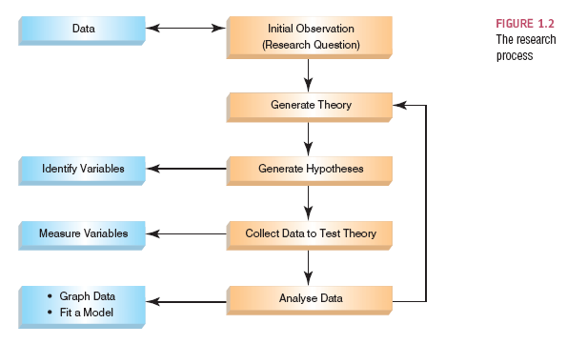
The Research Process

Slide 4
Populations and Samples
Population
The collection of units (be they people, plankton, plants, cities, suicidal authors, etc.) to which we want to generalize a set of findings or a statistical model.
Sample
A smaller (but hopefully representative) collection of units from a population used to determine truths about that population

Slide 5
The Only Equation You Will Ever Need

Slide 6
A Simple Statistical Model
In Statistics we fit models to our data (i.e. we use a statistical model to represent what is happening in the real world).
The mean is a hypothetical value (i.e. it doesn’t have to be a value that actually exists in the data set).
As such, the mean is simple statistical model.
Notes:
One of the simplest models we use in statistics is the mean. Some of you may have trouble thinking of the mean as a model, but in fact it is because it represents a summary of data. The mean is a hypothetical value that can be calculated for any data set, it doesn’t have to be a value that is actually observed in the data set. For example, if we took five statistics lecturers and measured the number of friends that they had, we might find the following data: 1, 3, 4, 3, 2. If we take the mean number of friends, this can be calculated by adding the values we obtained, and dividing by the number of values measured:. Now, we know that it is impossible to have 2.6 friends (unless you chop someone up with a chainsaw and befriend part of their remains, which in practice has proved disturbing) so the mean value is a hypothetical value. As such, the mean is a model that we create to summarise our data.

Slide 7
Parameters
Numbers estimated from the data to represent the population
So I can say that generally, people overestimate by about 50 points (the intercept in regression)
And increase those estimations by .27 for larger values (the slope in regression)
Sample statistics = the numbers estimated from a single test/study/experiment
Usually you refer to statistics as one study, parameters as the generalized idea.
Parameters = Greek symbols
Statistics = Latin letters (“normal English”)

Slide 8
Measuring the ‘Fit’ of the Model
The mean is a model of what happens in the real world: the typical score
It is not a perfect representation of the data
How can we assess how well the mean represents reality?

Slide 9
Bad fitting model From real data
erin‘s associative judgment research

Slide 10
Poor fitting model From real data
erin‘s associative judgment research

Slide 11
Good fitting model From real data
erin‘s associative judgment research

Slide 12
A Perfect Fit
Rating (out of 5)
Rater

Slide 13
Calculating ‘Error’
A deviation is the difference between the mean and an actual data point.
Deviations can be calculated by taking each score and subtracting the mean from it:

Slide 15
Use the Total Error?
We could just take the error between the mean and the data and add them.
Score | Mean | Deviation
1 | 2.6 | -1.6
2 | 2.6 | -0.6
3 | 2.6 | 0.4
3 | 2.6 | 0.4
4 | 2.6 | 1.4
 | Total = | 0

Slide 16
Sum of Squared Errors
We could add the deviations to find out the total error.
Deviations cancel out because some are positive and others negative.
Therefore, we square each deviation.
If we add these squared deviations we get the Sum of Squared Errors (SS).

Slide 17
Score | Mean | Deviation | Squared Deviation
1 | 2.6 | -1.6 | 2.56
2 | 2.6 | -0.6 | 0.36
3 | 2.6 | 0.4 | 0.16
3 | 2.6 | 0.4 | 0.16
4 | 2.6 | 1.4 | 1.96
 |  | Total | 5.20

Slide 18
Mean squared Error (standard deviation)
Although the SS is a good measure of the accuracy of our model, it depends on the amount of data collected. To overcome this problem, we use:
WHAT?

Slide 19

Degrees of Freedom
Sample
Population
11
7
8
8
12
15
?
9

Slide 20
Quick Summary
So, Mean square error = standard deviation
These values tell you model fit
Large values indicate poor model fit
Small values indicate better model fit
Remember that SD is based on the scale of the variable
So always think about how much the scale can vary to see if you are estimating it well

Slide 21
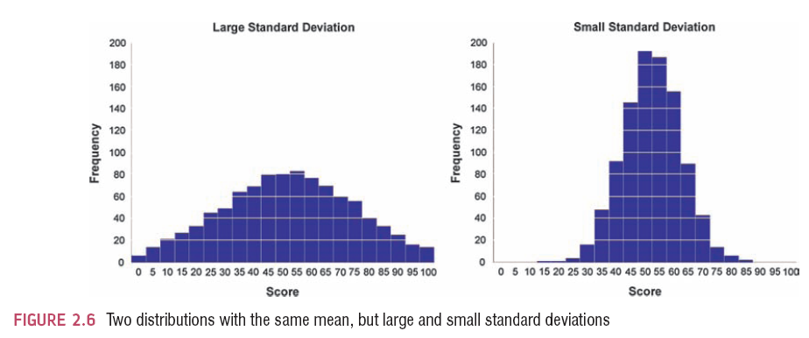
The SD and the Shape of a Distribution

Slide 22
Why?!?!
These sets of mathematical principles are called
Methods of Least Squares or Least Squared Error
Nearly every type of common statistic is estimated based on this idea
Z scores, t-tests, ANOVA families, regression, etc.
Other types of estimation:
Bayesian
Maximum Likelihood
Asymptotically Distribution Free

Slide 23
The Standard Error
SD tells us how well the mean represents the sample data.
But, if we want to estimate this parameter in the population, then we need to take multiple samples

Slide 24
Sampling Variation

Slide 25
Population
μ = 10
M = 10
M = 9
M = 11
M = 10
M = 9
M = 8
M = 12
M = 10
M = 11

Slide 26
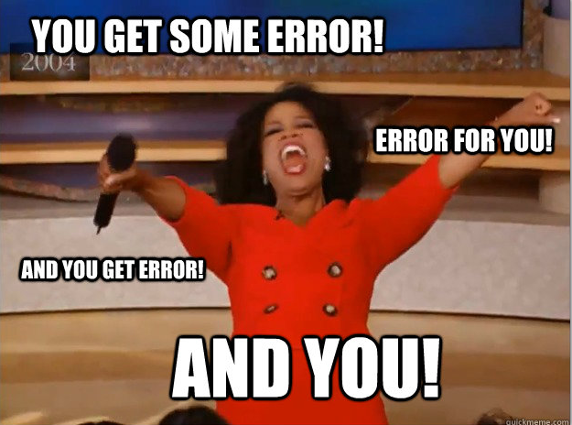
Standard Error
The previous slides describe the sampling distribution
In real life, we wouldn’t really do this work
Smart people have shown with Monte Carlos how these things work, which lead to the Central Limit Theorem
If N = 30, then we can estimate the standard deviation of the sampling distribution (standard error) by dividing by N from one sample.
I think about this as dividing up the error by person…you get an error! And you! And you!

Slide 27
Confidence Intervals
Back to erin’s associative judgment studies
We have tested about 30 of these, so have an idea of what the population parameters are.
True Mean (µ = .30)
Sample Mean (M = .27)
Interval estimate
.15-.39 (contains true value)
.26-.28 (misses true value)
CIs constructed such that 95%/99% contain the true value.

Slide 28
CIs for Z-scores
We’ve already talked about how +/- 1.96 and +/- 2.58 are the Z-score cut offs for 95% and 99%
We want to create an interval around the mean
But we want it to be in real units, not Z scores
Mean + Zscore cut off (SE) upper limit
Mean – Zscore cut off (SE) lower limit
We’ll talk about different formulas when we get to those tests

Slide 30
Showing Confidence Intervals Visually

Slide 31
Types of Hypotheses
Null hypothesis, H0
There is no effect.
E.g. There will no relationship between participant scores and real judgments (i.e. Slope = 0); they are wild guessing
The alternative hypothesis, H1
AKA the experimental hypothesis
E.g. There will be a relationship between participant scores and real judgments (i.e. Slope /= 0); they have at least some idea of the numbers.

Slide 32
What does Statistical Significance (NHST) Tell Us?
The importance of an effect?
No, significance depends on sample size.
That the null hypothesis is false?
No, it is very unlikely.
That the null hypothesis is true?
No, it is never true, just likely.
Another problem with NHST is that it encourages all or nothing thinking.

Slide 33
Test Statistics
A Statistic for which the frequency of particular values is known.
Observed values can be used to test hypotheses.
This is the basic gist for ANOVA, t-tests, regression, chi-square.

Slide 34
One- and Two-Tailed Tests
Careful, most people consider 1-tailed tests cheating.

Slide 35
Type I and Type II Errors
Type I error
occurs when we believe that there is a genuine effect in our population, when in fact there isn’t.
The probability is the α-level (usually .05)
Type II error
occurs when we believe that there is no effect in the population when, in reality, there is.
The probability is the β-level (often .2)
Power
The probability of finding an effect when you should.
The probability is usually 1- β = .8
See chart drawn in class.

Slide 36
What to do?!
Use corrections
Family wise
Experiment wise
Example corrections
Bonferroni
Sidak-Bonferroni
Tukey
Scheffe
Etc.

Slide 37
Power
Power is influenced by:
Effect size
SD
Mean differences
Alpha
Type of test
Sample size
G*Power
http://www.psycho.uni-duesseldorf.de/abteilungen/aap/gpower3/download-and-register

Slide 38
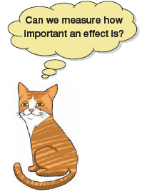
Effect Sizes
An effect size is a standardized measure of the size of an effect:
Standardized = comparable across studies
Not (as) reliant on the sample size
Allows people to objectively evaluate the size of observed effect.

Slide 39
Effect Size Measures
There are several effect size measures that can be used:
Cohen’s d
Pearson’s r
Glass’ Δ
Hedges’ g
R², ɳ², ω²
Odds Ratio/Risk rates

Slide 40
Effect Size Measures
r = .1, d = .2 (small effect):
the effect explains 1% of the total variance.
r = .3, d = .5 (medium effect):
the effect accounts for 9% of the total variance.
r = .5, d = .8 (large effect):
the effect accounts for 25% of the variance.
Beware of these ‘canned’ effect sizes though:
The size of effect should be placed within the research context.

Slide 41
Reporting
Generally CIs are reported in [ ]
M = .27 [.15, .39]
But you will also want to denote what type of CI at some point (95% or 99%)
APA requests exact p values.
So you use p = .15 or p = .02
p < .001 rule for .000 in R.
All test statistics should include
Test statistic (i.e. F, t) and df
P value
Effect size

